Slide 1


WELCOME
TO
BROWSER
BASED
EXTENSION

Slide 2

PRESENTATION ON
WEB CLIPPER EXTENSION
SUBMITTED BY:
CHANPREET SINGH(1311369)
ARVINDER KAUR (1311359)

Slide 3


INTRODUCTION TO BROWSER BASED EXTENSION :
A browser extension is a plug-in that extends the functionality of a web browser. Some extensions are authored using web technologies such as HTML, JavaScript, and CSS. Others are developed using machine code and application programming interfaces (APIs) provided by web browsers, such as NPAPI and PPAPI. Browser extensions can change the user interface of the web browser without directly affecting viewable content of a web page; for example, by adding a browser toolbar.

Slide 4
By Using this Evernote extension anyone can save things you see on the web into your Evernote account. Clip the web pages you want to keep.
Save them in Evernote. Easily find them on any device. This can be Great for research one can clip any article or web page and to a specific notebook and assign tags.
Use Evernote to find clips on any device highlight and share key text from any website or article .Use text and visual callouts to draw attention. Share and email clips or create a URL link.
User can also Clip the Gmail threads and
attachments or Clip as entire page.

Slide 5
CREATING NEW PROJECT
Each extension has the following files:
A manifest file.
One or more HTML files (unless the extension is a theme)
Optional: One or more JavaScript files
Optional: Any other files your extension needs—for example, image files.

Slide 6
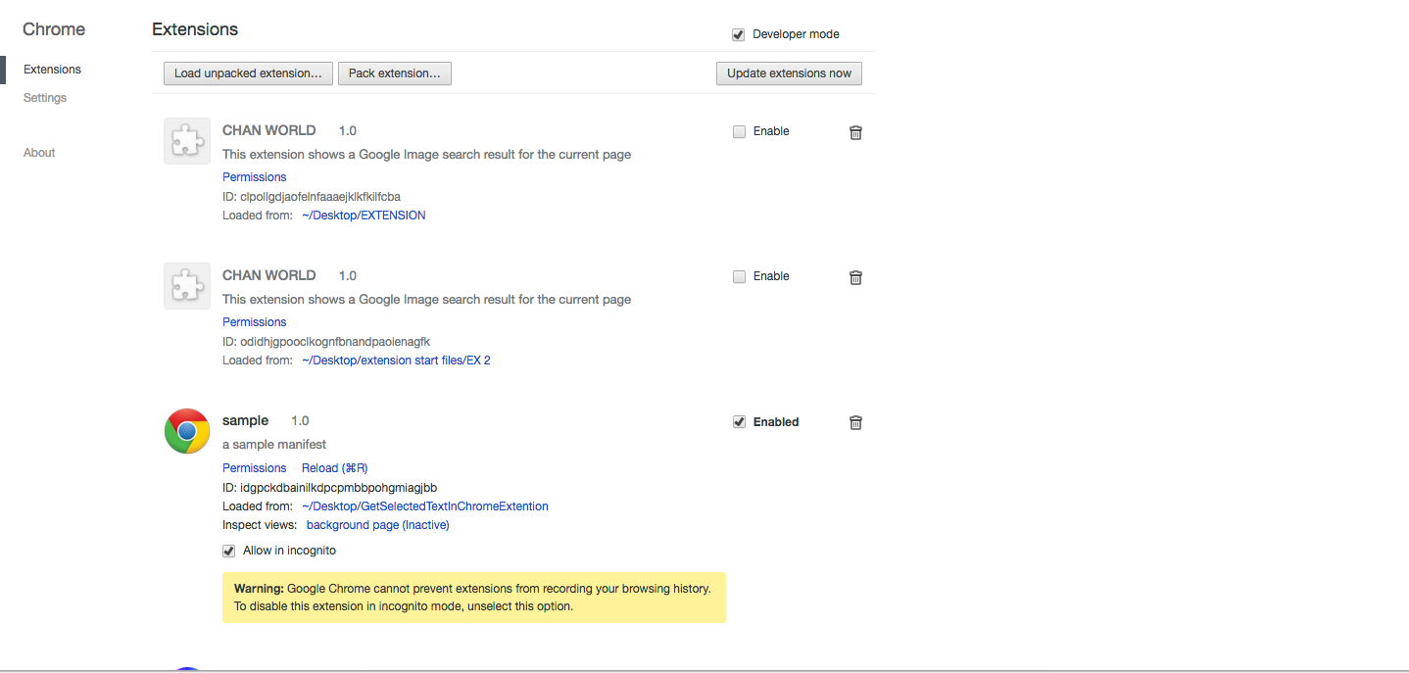
LAYOUT:
A layout defines the visual structure for a user interface , such as the UI for an Activity where user can enable or disable extension features under developer mode.

Slide 7
INTRODUCTION TO EVERNOTE WEB CLIPPER
Web clipping
Extracting static information from a Web site in order to display the data on a Web-enabled PDA. The idea behind Web clipping is to conserve the PDA's resources by extracting once any static data, such as graphics, logos, photos or even unnecessary text and storing that data on the PDA. The PDA will then make a wireless connection to a Web server in order to retrieve any dynamic content. Web clipping is a technology pioneered by Palm for its Palm VII handheld device.An excerpt of data taken from a Web server.

Slide 8
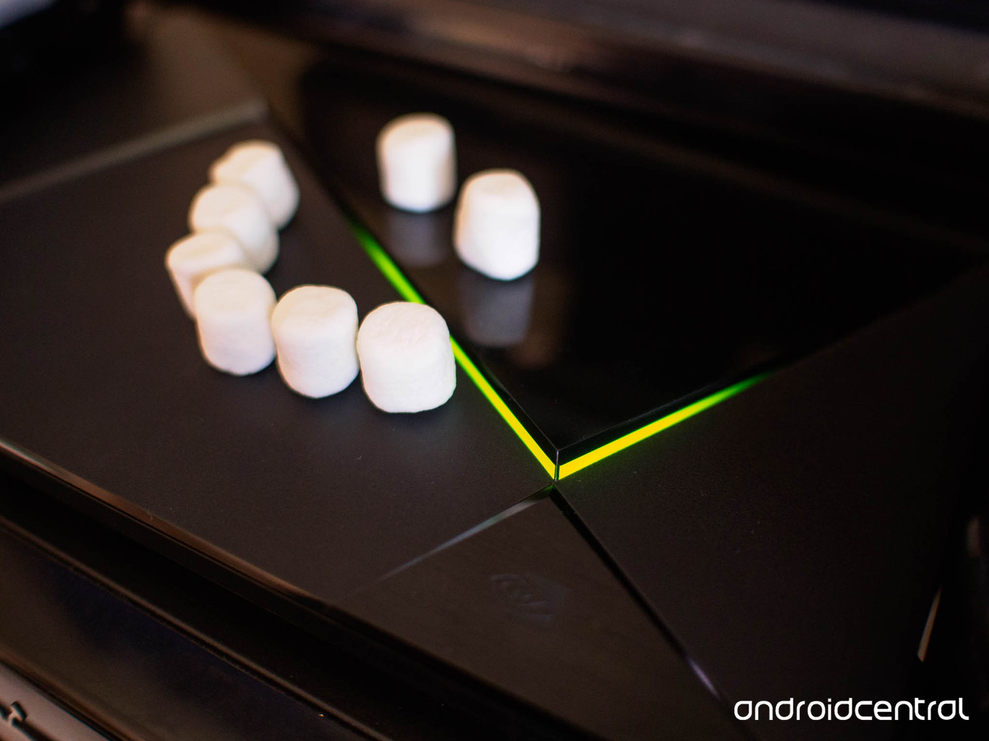
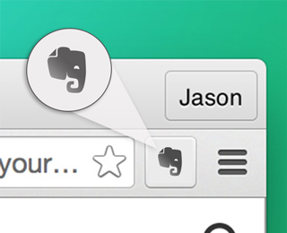
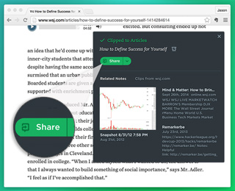
Save your first web clip in steps:
Launch Web Clipper to start clipping
Click the elephant button in your browser toolbar to launch Web Clipper.
Select a clip type, full-length or sections of web pages, such as news stories or research articles. Save time and review clipped content offline, during your commute.
Share with others
Click Share to share and discuss ideas with others. Clip design ideas to share with your team or post event details on a team page.

Slide 9
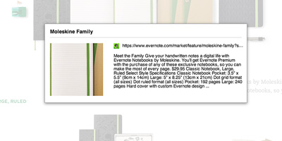
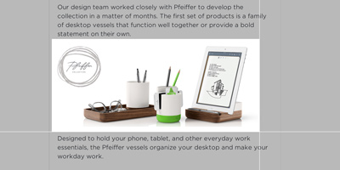
Bookmark
Want to remember a site without clipping the entire page Save the URL, an auto-generated thumbnail from the page, and a snippet of text. Add comments to the clip and recall what was inspiring or informative.
Screenshot
Take a static snapshot of a page as it appears on the screen. Once you've captured the screenshot, you can crop the image and add text, shapes, stamps and other visual callouts.

Slide 10
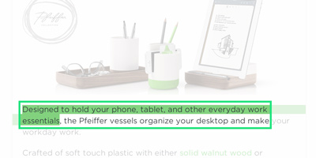
Selection
Select some text or pictures in a web page before opening the Web Clipper. Only the text or images you've selected are saved to Evernote.

Slide 11
Unique Features of the System
Quick actions
A robust and highly available service to store and remember everything.
Make a note of it
Create a project to-do list. Jot down a reminder. Or snap a picture of a sketch. A note can be anything you want it to be. And once you make a note, it’s accessible wherever you go, forever.

Slide 12
Have it everywhere
Capture a note once, and it’s instantly available on all your devices. Never worry about where you saved something because it’s in Evernote, and Evernote is wherever you are.
Find anything fast
Whether it’s text, images or documents, you keep things for a reason. That’s why Evernote makes sure the notes you’ve saved are easy to find. You can even search for handwritten words buried deep within your notes.
Share with anyone
Share what matters with the people who matter to you. Capture life’s little moments and share them from wherever you happen to be. Or share big ideas by collaborating seamlessly

Slide 13


Conclusion and Future Scope
Highlight text
To highlight text on a web page, simply click and drag the highlighter cursor across text on a page. To remove highlights, hover over the highlighted text and click the 'X'.

Slide 14

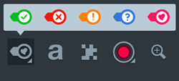
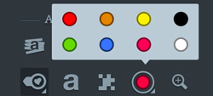
Shape tool
Draw arrows, circles, lines, and other shapes on a screenshot.
Color options:
Choose or edit the color of your new or selected shapes.

Slide 15
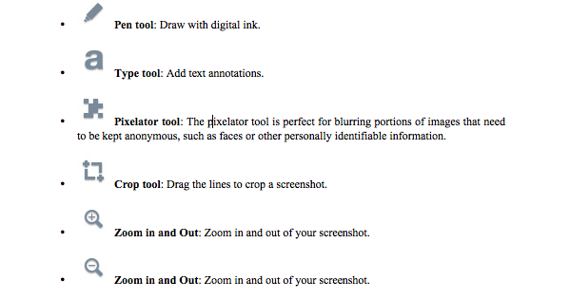
Other annotation tools:

Slide 16

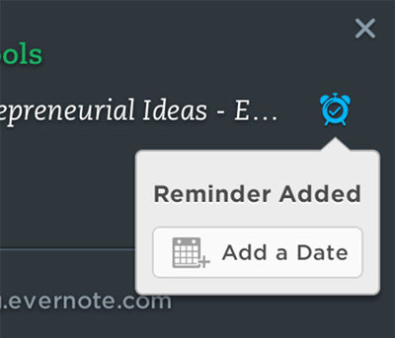
More tips
Clip emails from Gmail or Outlook
2. Clip from Gmail
From Gmail, launch the Web Clipper, then click Email to save a clean, clutter-free version of gmail messages
(and selected threads)
directly into your
Evernote account.
3. Clip from Microsoft Outlook
From Outlook, click New Clip from the toolbar to clip emails, contacts, and calendar events directly to your Evernote account.
4. Add notification alerts to web clips

Slide 17
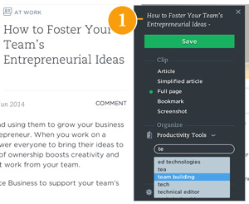
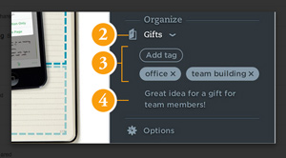
Organize clips
Once you click Save, Web Clipper smart filing automatically stores both the contents and the URL of a web page into Evernote, as a note in your default notebook.

Slide 18
The scope is intended to be fulfilled because of the systems following features :
Secure :
The project is provided with a proper back up maintained for the security of the information.
Easy to Use :
The users are provided with his own id and password to have a proper and secured access to the software and the it is easy to use. The user friendly interfcae helps the users to understand the Extension.
Reliable and accurate :
An accurate and to the date information is being stored which can be viewed as and when required.

Slide 19


